Slide 1






ResumeGenie: Intelligent Resume Optimization with LLMs
Graduates Rising in Information and Data Science
Aryan Vats
MS in CS
Nidhi
Choudhary
MS in ADS
Eben Gunadi
MS in DS (Healthcare)
Muqi Zhang
MS in CS
Justin Chen
BS in DS

Slide 2





Table of Contents
Problem Understanding
Challenges in Traditional Resume Creation
Need for Intelligent Automation
Solution Orchestration
High-level Architecture
Key Entities and Components
Deep Dive into the Solution Workflow
PDF to JSON Parsing
Prompt Engineering for Personalization
RAG (Retrieval-Augmented Generation) for Smart Matching
Converting JSON Back to PDF
Application Walkthrough and Result
Previous Resume vs. New Generated Resume: Comparison and Insights
GRIDS

Slide 3



Why are we here?
Situation
Complication
Key Question
The job market is highly competitive, and landing the right role is tougher than ever.
On top of that, Applicant Tracking Systems (ATS) filter out many resumes before they even reach a recruiter.
Candidates need strong, ATS-compliant resumes to even get noticed.
Most resumes fail to stand out due to generic content and lack of strategic positioning.
Creating a structured, impactful, and keyword-optimized resume for every application is critical — but time-consuming.
Manually tailoring resumes to each job description is unrealistic when candidates need to apply to dozens of roles quickly.
How can we leverage technology, especially LLMs, to automate and personalize resume generation – making every resume tailored, ATS-friendly, and impactful – to maximize a candidate's chances across multiple job applications?
GRIDS

Slide 4
Solution Orchestration
Graduates Rising in Information and Data Science

Slide 5







Solution Orchestration
Streamlit Application
Candidate Upload: Raw input files (resume PDFs and Job Descriptions)
Parsing Layer: Resume parsing (PDF → JSON)
Prompt Engineering: Craft structured prompts for LLM based on parsed data
Matching & Ranking: Search and match using Vector Database (resume embeddings vs. job description embeddings)
Resume Generation: Fine-tuned resume generated (using LLM with engineered prompts)
Output: Downloadable final resume (JSON → PDF)
Candidate Upload
Parsing Layer
Matching & Ranking
Resume Generation
{ S }
Output
Download
GRIDS
Notes:
The candidate first uploads their raw resume and the corresponding job description through our web interface.
On the backend, we immediately capture these files and start parsing. We use PDFPlumber to extract raw text from the PDFs, Pydantic to organize the extracted data into a structured JSON schema, and then leverage ChatGPT-4o to further refine and format the JSON output cleanly.
After parsing, we move into the matching and ranking part. Here we involve Retrieval-Augmented Generation (RAG) technique. Using ChromaDB, we store and query resume embeddings to retrieve the top two most relevant resume examples based on the candidate's field.
These retrieved examples are then fed into a LangChain pipeline. We construct a few-shot prompt by combining the retrieved examples with the original parsed data to guide the LLM more accurately during resume generation.
The LLM then generates a fine-tuned, ATS-optimized resume for the candidate.
Finally, the generated resume is displayed on the web application and can be downloaded by the candidate in PDF format.

Slide 6
Deep Dive into the Solution Workflow
Graduates Rising in Information and Data Science

Slide 7
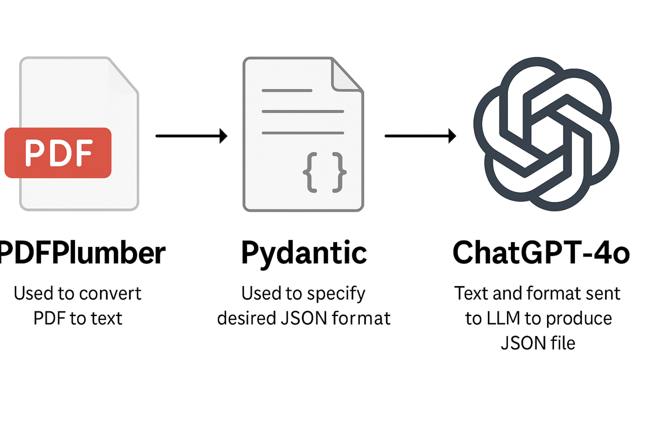
Parsing with PDFPlumber, Pydantic and ChatGPT-4o
PDFPlumber
Used to convert PDF to text
Pydantic
Used to specify desired JSON format
Text lines get organized neatly into boxes { key: value }
ChatGPT-4o
Finally, text and format sent to LLM to produce JSON file
Neatly formatted JSON file produced by the AI
GRIDS
Notes:
after the user uploads their PDF, we first extract the PDF text using PDFPlumber. to convert this text into JSON format, we use pydantic to specify the desired format or key-values. then both the text and this format is sent to ChatGPT to produce the final JSON file.

Slide 8
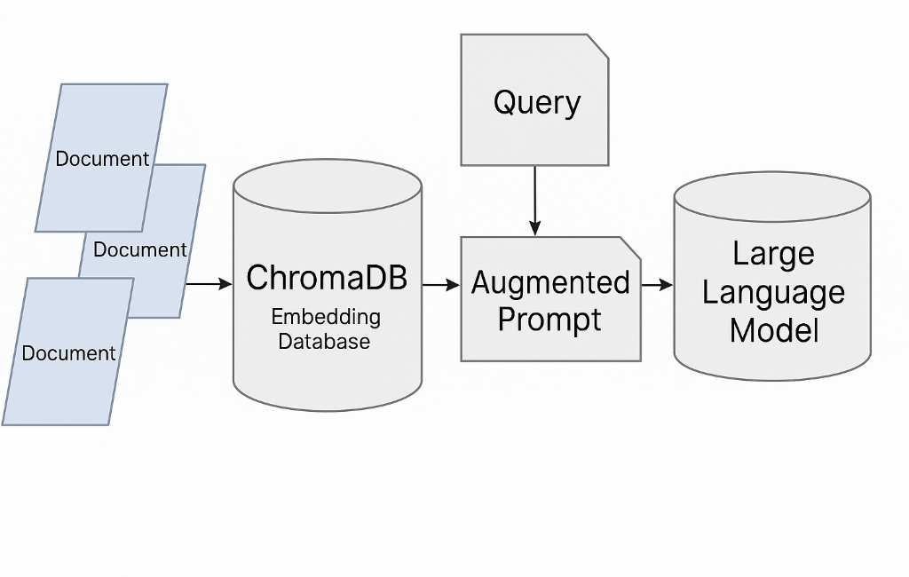


ChromaDB for Retrieval Augmented Generation (RAG)
RAG Architecture
Create a knowledge base for the LLM to reference
Reduce hallucinations by grounding responses to the retrieved information
ChromaDB
Open source vector database
Stores data as numerical vectors with embeddings
Quickly queries relevant documents with similarity metrics
GRIDS
Notes:
the JSON extracted from the user’s PDF will then updated with a strategy called retrieval augmented generation, also known as RAG. we create a knowledge base of tried and true resumes that the LLM references when augmenting our JSON. this grounds the final output to the retrieved information and reduces hallucinations. for reference, the knowledge base we used is a vector database called chromaDB. vector databases store data as numerical vectors with embeddings, and can query relevant documents by finding the similarity between those vectors.

Slide 9






Langchain Framework Flow
Get examples from RAG
Few-Shot Prompt
Full Prompt
LLM
Parse Output
Json Resume
Input Chain: Raw resume is ingested through a Chain with a custom Prompt Template to extract the major/field.
Retriever Query: A Retriever searches ChromeaDB for top 2 similar resumes based on the extracted field.
Few-Shot Prompt Assembly: Retrieved example resumes are inserted into a Few-Shot Prompt Template to condition the LLM.
Resume Generation Chain: The LLM generates an ATS-friendly resume using the few-shot examples and original input.
Output Parsing: An Output Parser ensures the generated resume has structured fields.
GRIDS
Notes:
On this slide, you can see the flow we’ve built using LangChain to transform a raw resume into an ATS-ready JSON document. Let’s walk through each step.
Input Chain
First, we ingest the candidate’s raw resume into an Input Chain. This Chain applies a custom PromptTemplate to extract and identify applicant’s major or field of expertise—which we’ll use to drive our retrieval logic.
Retriever Query
Next, that extracted field powers a Retriever connected to a ChromaDB, where the vector stores. We perform a similarity search to fetch the top two examples of domain-matched resumes from our RAG database. These examples will serve as our few-shot conditioning example to demonstrate to the LLM what is a success change to make it ATS-ready.
Few-Shot Prompt Assembly
With those retrieved resumes in hand, we assemble a FewShotChatMessagePromptTemplate. This template allows the LLM to understand what a good change looks like.
Resume Generation Chain
We then pass the combined prompt—system instruction, few-shot examples, and the candidate’s raw resume—into a second Chain, powered by ChatOpenAI. The LLM generates an ATS-compliant JSON resume, using the patterns illustrated in our examples.
Output Parsing
Finally, an Output Parser cleans and validates the LLM’s response, ensuring the result is well-formed JSON with structured fields.

Slide 10
Application Walkthrough and Result
Graduates Rising in Information and Data Science
GRIDS

Slide 11
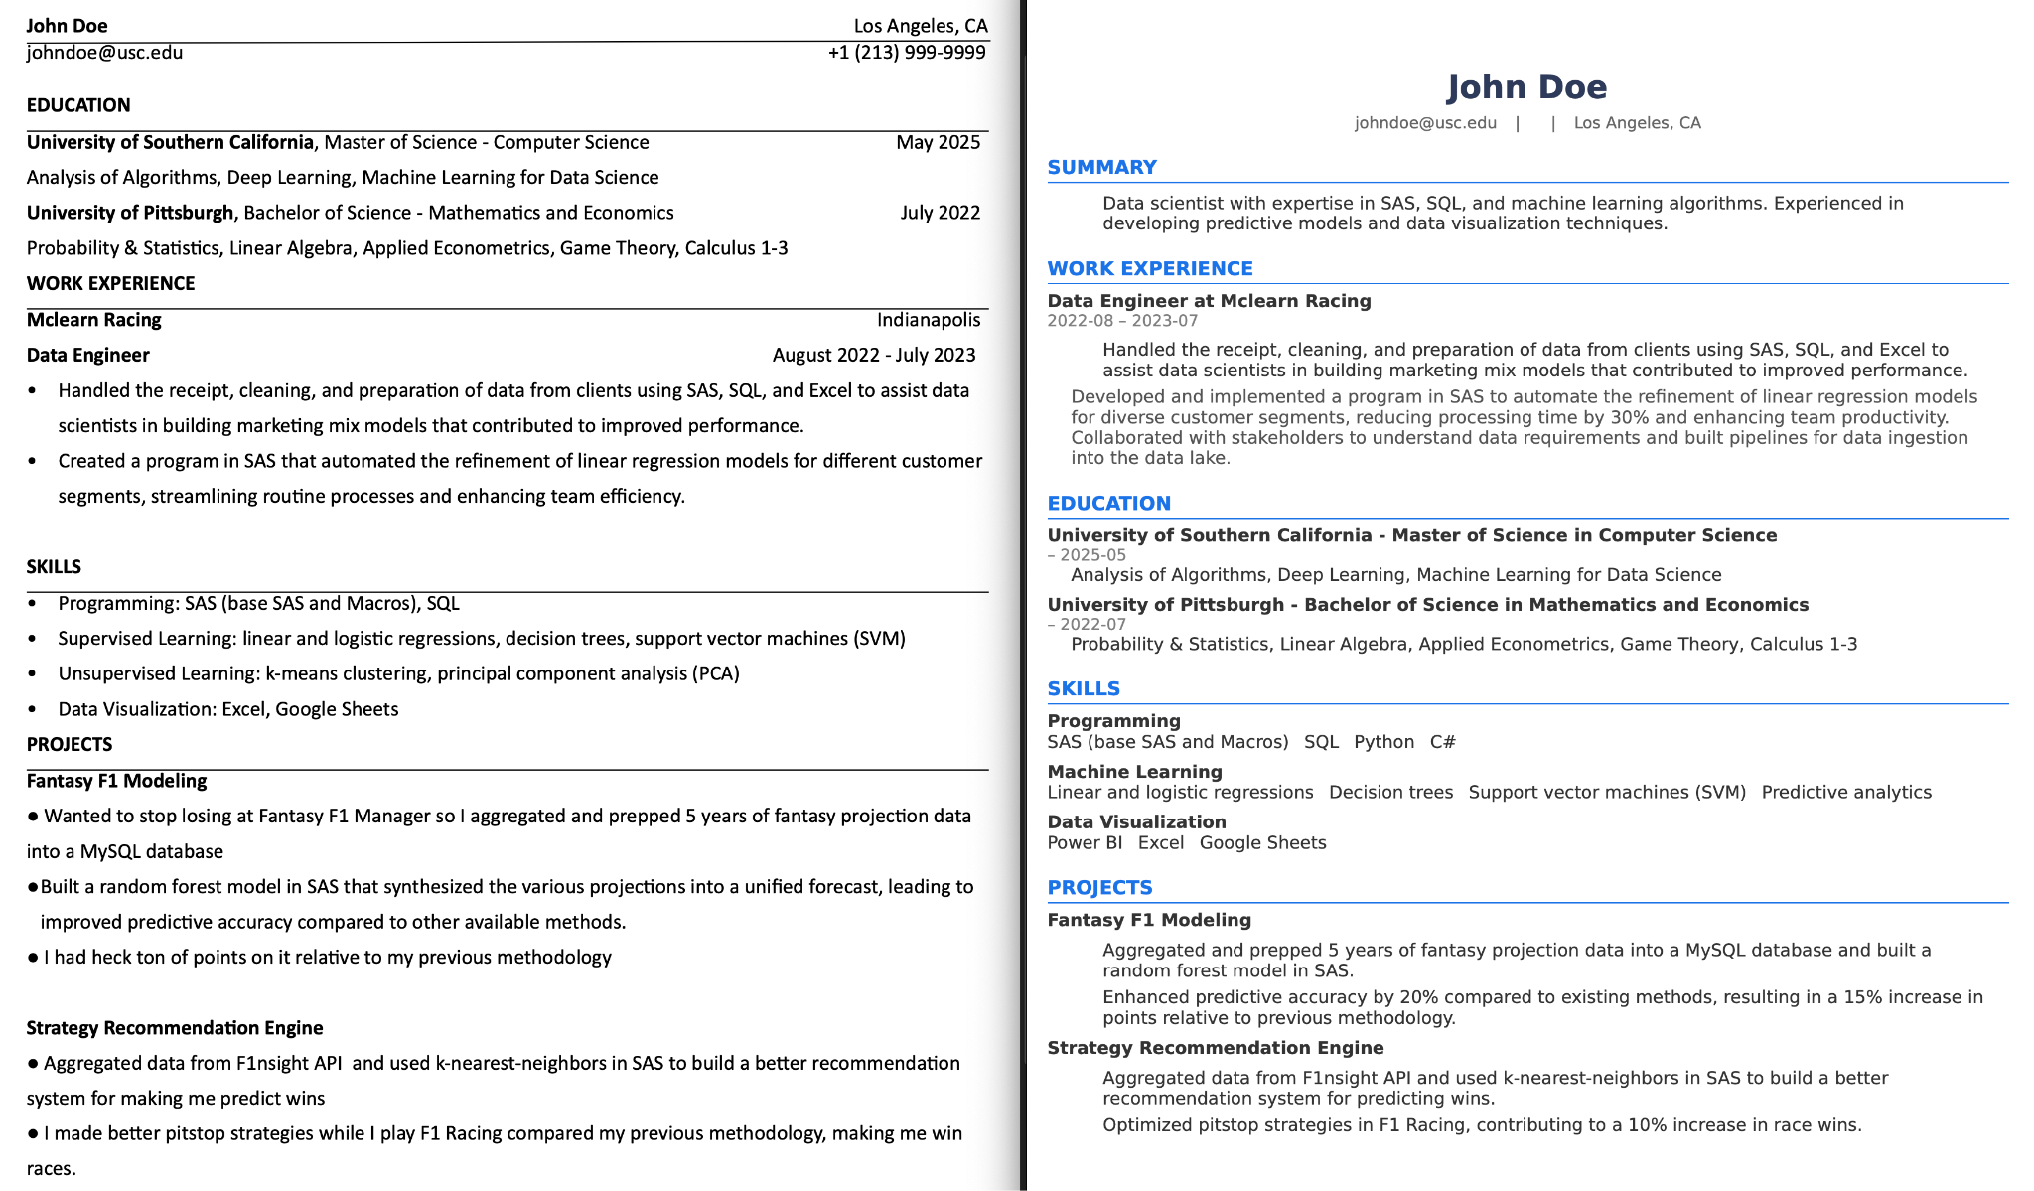
Comparing Results
GRIDS
Notes:
On this slide, you can see the flow we’ve built using LangChain to transform a raw resume into an ATS-ready JSON document. Let’s walk through each step.
Input Chain
First, we ingest the candidate’s raw resume into an Input Chain. This Chain applies a custom PromptTemplate to extract and identify applicant’s major or field of expertise—which we’ll use to drive our retrieval logic.
Retriever Query
Next, that extracted field powers a Retriever connected to a ChromaDB, where the vector stores. We perform a similarity search to fetch the top two examples of domain-matched resumes from our RAG database. These examples will serve as our few-shot conditioning example to demonstrate to the LLM what is a success change to make it ATS-ready.
Few-Shot Prompt Assembly
With those retrieved resumes in hand, we assemble a FewShotChatMessagePromptTemplate. This template allows the LLM to understand what a good change looks like.
Resume Generation Chain
We then pass the combined prompt—system instruction, few-shot examples, and the candidate’s raw resume—into a second Chain, powered by ChatOpenAI. The LLM generates an ATS-compliant JSON resume, using the patterns illustrated in our examples.
Output Parsing
Finally, an Output Parser cleans and validates the LLM’s response, ensuring the result is well-formed JSON with structured fields.

Slide 12
THANK YOU
Graduates Rising in Information and Data Science
ress-gen.streamlit.app
GRIDS

